Slide 1
Page object model & page factory Pattern
Rosario, january 2019

Slide 2
agenda
Why Page Object Model?
What Is Page Object Model (POM)?
Advantages of Page Object Model
Best practices
Page Factory
References

Slide 3

Why Page object Model?
Problems detected with traditional automation methods:
OH MY GOD!!
Do I have to change the element locators in the entire test script?
The script maintenance gets hard with the time as the test suit grows
We should adjust locator when they change
Duplicate Code
Duplicity of locators
Unnecessary code increases the cost of maintenance

Slide 4
What Is POM?
Page Object Model is a design pattern to create an Object Repository for web UI elements.
It is a layer between the test scripts and UI and encapsulates the features of the page.
All the element locators used by the application will be stored in a class file separately from the test case.
It is not a framework.
Page Class contains
POM Design Pattern
Element locators
Methods performing operations on elements.
Page Class
Test Case
Test Case contains
Actual test scenario
Calls to methods in page class with arguments.
Locators & test script stored separately

Slide 5
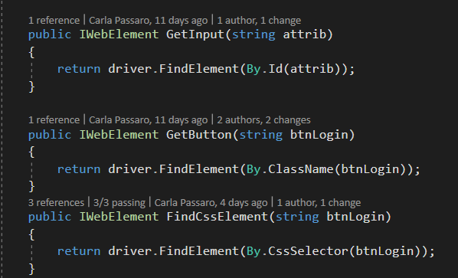
Advantages of the pom (1)
Once you made your design even if any locator or functionality changes on the web page you will know exactly where to change your code.
Easy to maintain
Locators: way of selecting an object on a page (e. g: the element’s ID, the element’s name attribute, an XPath statement, by a link’s text, document object model (DOM))

Slide 6
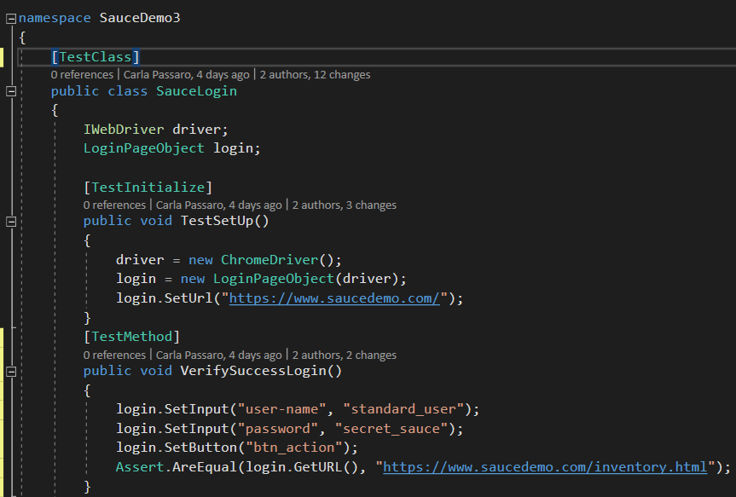
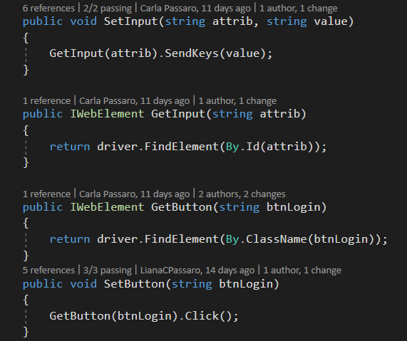
Advantages of the pom (2)
Clean and understandable code
Instead of using the same code all over your test framework, many features are defined within the page objects. Hence the lines of codes written is reduced and your code becomes easier to understand.

Slide 7
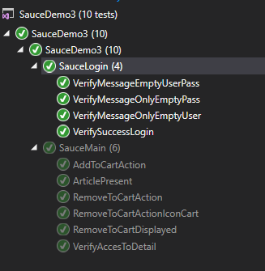
Advantages of the pom (3)
Helps you point out the UI
Better test scripts
Since you create page classes for almost every page on your web site, it is easy to comprehend the functionality and model of your web site even at a glance on your test frameworks.
Your test scripts will consist descriptive method names instead of incomprehensible and hard-coded code.

Slide 8
Best practices
A POM should not have any assertions
A POM should represent meaningful elements of a page and not necessarily a complete page
When you navigate to another page, the POM should create and return another page object for the next page.

Slide 9
Page Factory
Page Factory in Selenium is an extension to the Page Object design pattern.
It is used to initialize the elements of the Page Object or instantiate the Page Objects itself.
It is used to initialize elements of a Page class without having to use ‘FindElement’ or ‘FindElements’.
POM Implementation
ADVANTAGES
With
Page Factory
Without
Page Factory
Maintainability
Reusability
Flexibility
Optimized Code
Uses @FindBy().
Import package: Page Factory.
Uses @FindElement().
No imports needed.

Slide 10
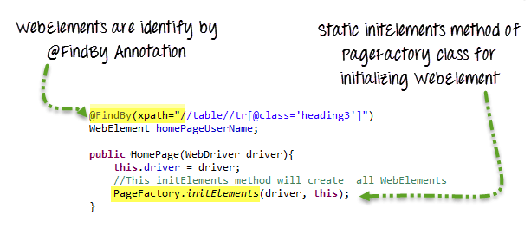
POM & Page factory

Slide 11
POM & Page factory
Using page factory
Using POm & page factory
package POMWithPageFactory;
public class LoginClassPageFactory {
WebDriver driver;
@Test
public void setup ()
{
driver = new ChromeDriver();
driver.get("https://www.saucedemo.com/");
WebElements locateElements = PageFactory.initElements(driver,
WebElements.class);
locateElements.loginMethod("standard_user","secret_sauce");
driver.quit();
}
}
package POMWithPageFactory;
public class WebElements {
WebDriver driver;
@FindBy(id="user-name") WebElement username;
@FindBy(how=How.ID, using = "password") WebElement password;
@FindBy(how=How.CLASS_NAME, using = "login-button") WebElement login;
public WebElements(WebDriver driver1){
driver = driver1;
}
public void loginMethod(String uid, String upwd){
username.sendKeys(uid);
password.sendKeys(upwd);
login.click();
}
}

Slide 12
POM & Page factory
Using only Pom
Without page factory
package pageObjects;
public class Login_Page {
private static WebElement element = null;
public static WebElement UserNameInput(WebDriver driver){
element = driver.findElement(By.id("user-name"));
return element;
}
public static WebElement PasswordInput(WebDriver driver){
element = driver.findElement(By.id("password"));
return element;
}
public static WebElement LogInBtn(WebDriver driver){
element = driver.findElement(By.className("login-button"));
return element;
}
public static void Login(WebDriver driver, String user, String pass){
Login_Page.UserNameInput(driver).sendKeys(user);
Login_Page.PasswordInput(driver).sendKeys(pass);
Login_Page.LogInBtn(driver).click();
} }
package testSuites;
public class MainPage {
String user = "standard_user";
String pass = "secret_sauce";
WebDriver driver;
@Test
public void setup ()
{
driver = new ChromeDriver();
driver.get("https://www.saucedemo.com/");
Login_Page.Login(driver, "standard_user", "secret_sauce");
driver.quit();
}
}

Slide 13
references
English references
https://medium.com/tech-tajawal/page-object-model-pom-design-pattern-f9588630800b
https://www.pluralsight.com/guides/getting-started-with-page-object-pattern-for-your-selenium-tests
https://www.toolsqa.com/selenium-webdriver/page-object-model/
https://www.softwaretestingmaterial.com/page-object-model/#Page-Factory
https://www.guru99.com/page-object-model-pom-page-factory-in-selenium-ultimate-guide.html
https://www.toolsqa.com/selenium-webdriver/page-object-pattern-model-page-factory/
Spanish references
https://josepablosarco.wordpress.com/2014/10/28/patron-page-object-para-pruebas-automatizadas/
http://adrianmoya.com/2013/09/aplicando-el-patron-page-object-en-la-automatizacion-de-escenarios/#sthash.K51wWofb.tV3k31wi.dpbs
https://qanewsblog.com/2014/08/07/patrones-de-diseno-en-automatizacion-page-objects/

Slide 14
Liana Carla Passaro
engineer
carla.passaro@endava.com

